Slide 1


BSRT: Improving Burst Super-Resolution with Swin Transformer and Flow-Guided Deformable Alignment
Ziwei Luo, Youwei Li, Shen Cheng, Lei Yu, Qi Wu, Zhihong Wen, Haoqiang Fan, Jian Sun, Shuaicheng Liu*
Megvii Technology
University of Electronic Science and Technology of China
https://github.com/Algolzw/BSRT

Slide 2


Challenges in Burst Super-Resolution
Inputs
HR image
Noisy
Misaligned
RAW frames
Challenges

Slide 3
BSRT: Improving Burst Super-Resolution with Swin Transformer and Flow-Guided Deformable Alignment
Main Contributions
Efficient pipeline for RAW bursts processing.
Pyramid flow-guided deformable convolution network (FG-DCN) for feature alignment.
Swin Transformer based burst features extraction and reconstruction.

Slide 4
BSRT: Improving Burst Super-Resolution with Swin Transformer and Flow-Guided Deformable Alignment
Visual comparison on BurstSR test dataset.

Slide 5
BSRT: Improving Burst Super-Resolution with Swin Transformer and Flow-Guided Deformable Alignment
Synthetic dataset
Real-world dataset
Performance comparison on Synthetic dataset and Real-world dataset.

Slide 6







BSRT Framework
Upscale
Reconstruction
…
PixelShuffle
$$×2$$
Pyramid FG-DCN
Alignment
Upscale
$$x_{N}$$
$$x_{N−1}$$
$$x_{1}$$
Conv
ST Block
Fusion
⊕
ST Block
HR Image
ST Block
ST Block
ST Group
ST Group
ST Group
ST Group
RAW Burst Input
PixelShuffle $×2$
Feature Extraction
$$x_{N}$$
…
$$x_{1}$$
Top-3 Level Flows
ST Block
ST Block
ST Block
ST Block
ST Block
Conv
SpyNet
Conv
Swin Transformer Group

Slide 7












RAW Bursts Processing Pipeline
Flatten
EBSR pipeline:
$$x$$
Extract
Align
Restore
RGB Image
$$B,N,4,H,W$$
$$B,N,1, 2H,2W$$
$$B,C,2H,2W$$
$$B,3, 2Hs,2Ws$$
$$B,N,C,2H,2W$$
PixelShuffle x2
Our pipeline:
$$x$$
Extract
Align
Restore
RGB Image
$$B,N,4,H,W$$
$$B,N,C,H,W$$
$$B,C,2H,2W$$
$$B,3, 2Hs,2Ws$$
$$B,N,C, 2H,2W$$

Slide 8

Flow-Guided DCN
Fea1
Off Conv
Offset
⊕
Fea2
DCN
$$warp$$
Warped
Fea2
obtained from SpyNet
Flow
Aligned
Fea2
Flow-Guided DCN (FG-DCN)

Slide 9




Pyramid FG-DCN Alignment
L1
Fea1
Fea2
Flow
Conv
FG-DCN
Aligned
Fea2
$$×2$$
$$×2$$
L2
Fea1
Fea2
Flow
Conv
FG-DCN
Aligned
Fea2
$$×2$$
$$×2$$
L3
Fea1
Fea2
Flow
Conv
FG-DCN
Aligned
Fea2

Slide 10
Experiments
Synthetic dataset.
Real-world dataset.

Slide 11
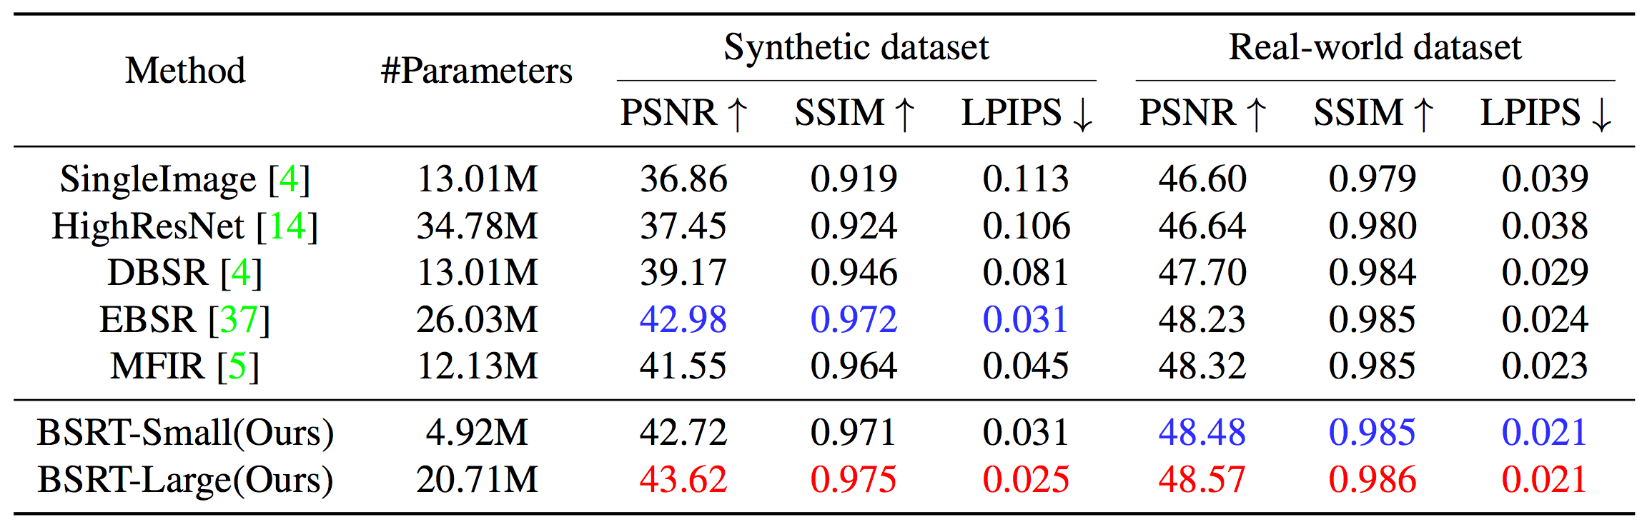

Quantitative results
Best
$2^{nd}$-best
The proposed BSRT achieves the best performance on both synthetic and real-world datasets.

Slide 12
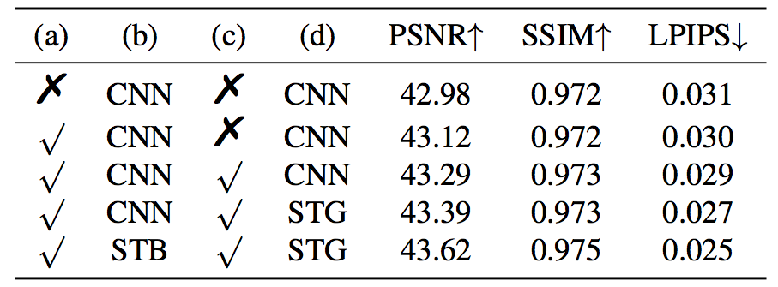
Ablation Study
Ablation studies of the main components on synthetic dataset.
  (a): Using the proposed RAW burst pipeline;
  (b): Network structure in feature extraction.
  (c): Using Pyramid FG-DCN in alignment;
  (d): Network structure in HR image reconstruction.

Slide 13
Visual results on Synthetic dataset
LR
Bicubic
DBSR
EBSR
MFIR
Ours
GT

Slide 14
Visual results on Real-world dataset
LR
Bicubic
DBSR
EBSR
MFIR
Ours
GT

Slide 15
Conclusion
We propose an efficient pipeline for RAW burst super-resolution task.
We propose a pyramid Flow-Guided DCN module which uses pyramid flows to guide the DCN to align features with multi-scale information.
We introduce the Swin Transformer in the feature extraction and reconstruction, which can further improve the performance.
The proposed BSRT achieves an art performance in burst super-resolution.

Slide 16
Thank you!

