Slide 1
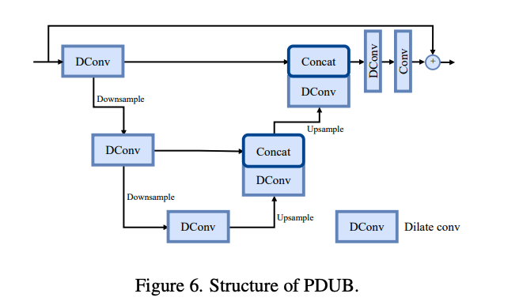
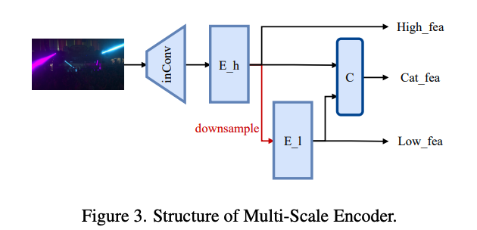
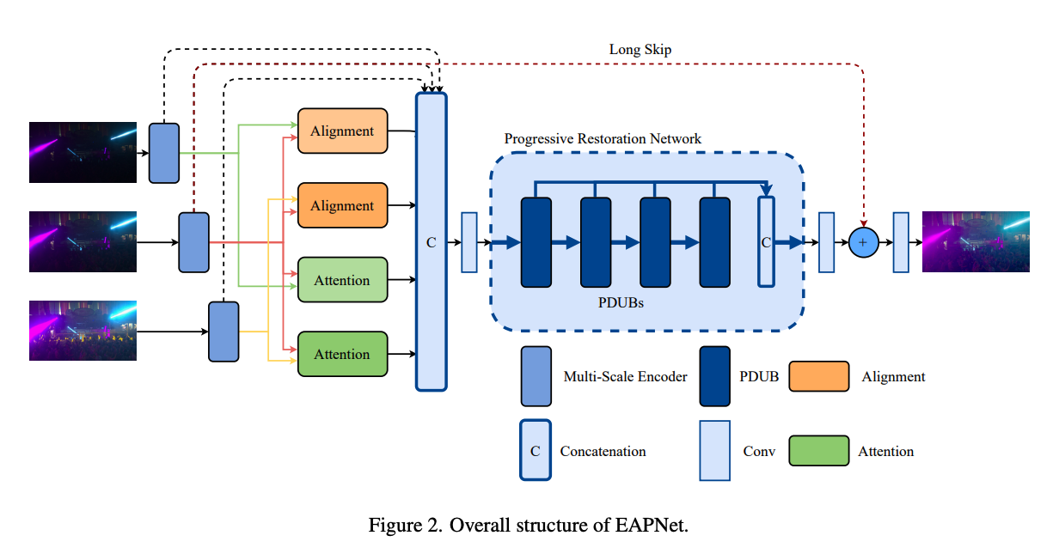
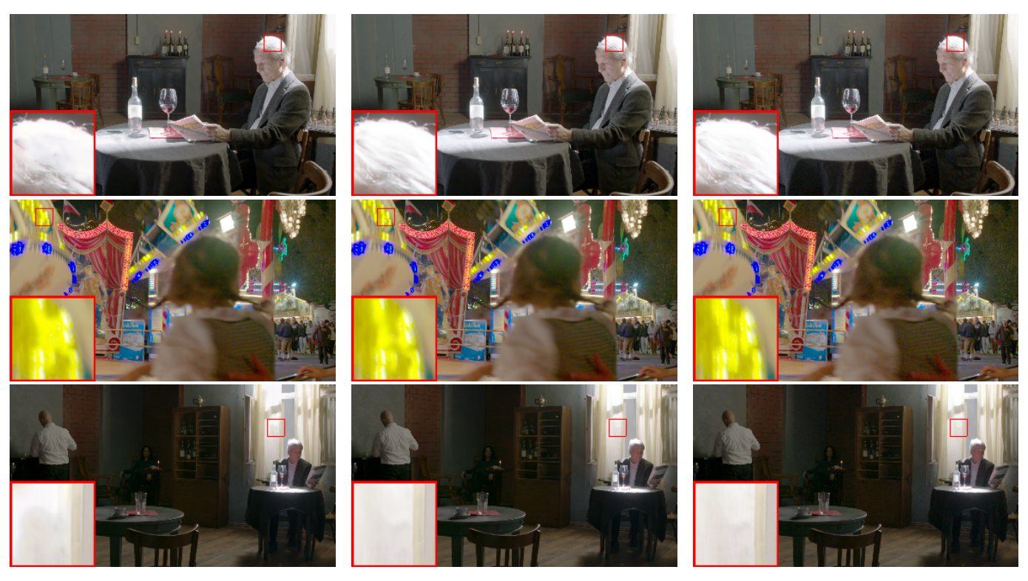
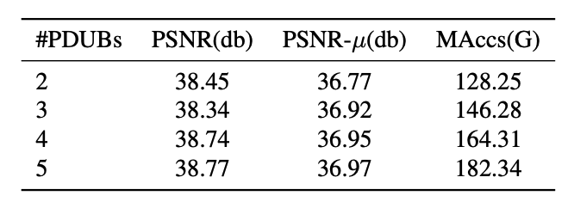
Efficient Progressive High Dynamic Range Image Restoration via Attention and Alignment Network Gaocheng Yu, Jin Zhang, Zhe Ma, Hongbin Wang (Ant Group) {yugaocheng.ygc, zj346862, mz281827, hongbin.whb}@antgroup.com
Contributions
Propose an efficient HDR Network called Efficient Attention-and-alignment-guided Progressive Network (EAPNet).
Propose Progressive Dilated U-shape Block (PDUB), which consists of miniature U-shape structures, and achieve good performance, extremely low computation cost，and strong adjustability.
In consideration of noise and flops, we introduce a multi-scale encoder module to deal with high and low frequency image signals.
We won the second place in NTIRE 2022 HDR Challenge in both track 1 (for fidelity) and track 2 (for low complexity)，exceeding the AHDR baseline provided by NTIRE 2022 HDR organizers by 0.16db in PSNR-µ and 0.4db in PSNR, with about 15× compression in Maccs. And in terms of complexity, our lightweight EAPNet achieves about 20x compression in MAccs, with PSNR maintained the same as baseline and a slight improvement in PSNR-µ.
Table1. Top5 Results of NTIRE 2022 HDR Challenge Track 1
Experiments & Quantitative Results
Dataset is provided by NTIRE 2022 HDR Challenge, containing 1494 triplets for training, 201 triplets for testing.
Ablation studies:
Experiments on number of PDUBs：
Results of NTIRE 2022 HDR Challenge Track 1 (Table 1)
Results of NTIRE 2022 HDR Challenge Track 2 (Table 2)
Table2. Top5 Results of NTIRE 2022 HDR Challenge Track 2
Proposed Architectures
Qualitative Results
AHDR
Ours (EAPNet)
Ground-Truth

