Slide 1
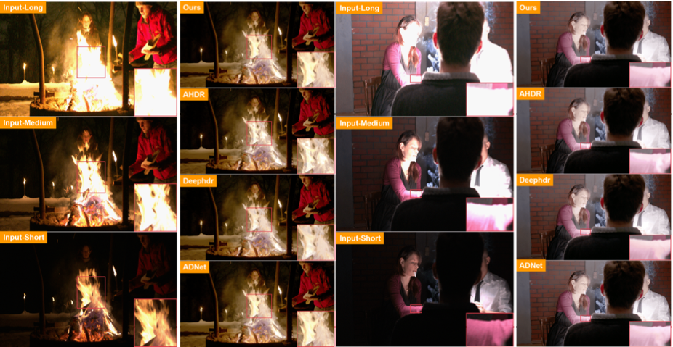
A Lightweight Network for High Dynamic Range Imaging Qingsen Yan¹, Song Zhang², Weiye Chen², Yuhang Liu¹, Zhen Zhang¹, Yanning Zhang³, Javen Qinfeng Shi¹, Dong Gong⁴
¹The University of Adelaide, Australia, ²Xidian University, China, ³Northwestern Polytechnical University, China,
⁴The University of New South Wales, Australia
Introduction
The Proposed Method
Experiment
Recovering a high dynamic range (HDR) image from a series of low dynamic range (LDR) images with motion mis-alignment and over/under-exposure problem.
Previous methods generate high-quality HDR images with high computational complexity, and the inference process is too slow.
HUNet: Considering the computation complexity and the number of parameters, the fusion network employs two branches, UNet branch with a lightweight module for obtaining a larger receptive field and High-resolution branch for preserving local details.
Comparison to State-of-the-art:
Model | PSNR-$μ$ | PSNR | GMACs | Para.
DeepHDR[1] | 31.39 | 37.57 | 1983.38 | 16606339
AHDRNet[2] | 32.60 | 38.94 | 2916.92 | 1441283
ADNet[3] | 32.88 | 39.73 | 6249.43 | 3132773
DeepHDR* | 31.21 | 36.16 | 180.79 | 1096706
AHDRNet* | 31.26 | 36.32 | 186.17 | 90679
HUNet | 32.73 | 39.29 | 156.12 | 188992
Contributions
Visual Comparison:
We propose a lightweight hybrid network called HUNet with two branches (High-resolution branch and UNet branch) for HDR image deghosting and performs better effectively and efficiently than prior work.
We propose a dual attention module to extract the features of well-exposed regions, and force the fusion network to learn more details for degenerated regions with residual operation.
We utilize a lightweight (LW) module to effectively fuse features with fewer parameters and achieve better performance.
Dual attention module: highlights the useful regions of the reference image and forces the fusion network to learn the details of degenerated regions with a residual.
Reference
Lightweight (LW) module: Considering the redundancy in feature maps, we use the ghost block to generate more feature maps from cheap operations.
[1] Shangzhe.,Wu, et.al. Deep high dynamic range imaging with large foreground motions. In ECCV, 2018.
[2] Qingsen,,Yan, et.al. Attention-guided Network for Ghost-free High Dynamic Range Imaging. In CVPR, 2019.
[3] Zhen, Liu, et.al. ADNet: Attention-guided Deformable Convolutional Network for High Dynamic Imaging. In CVPR workshop, 2021.

