Slide 1
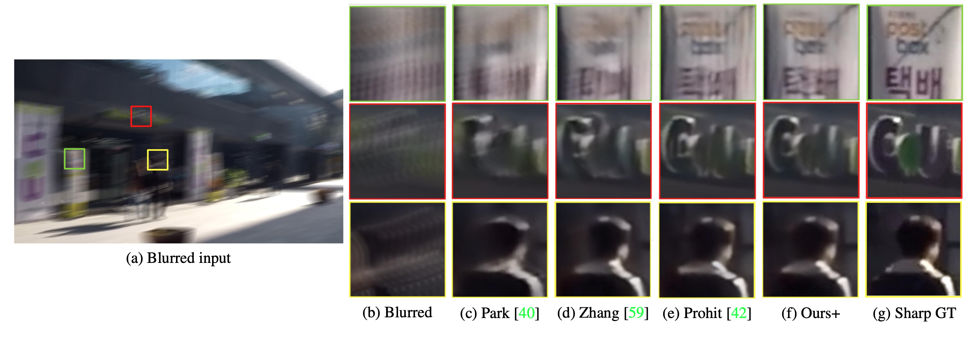
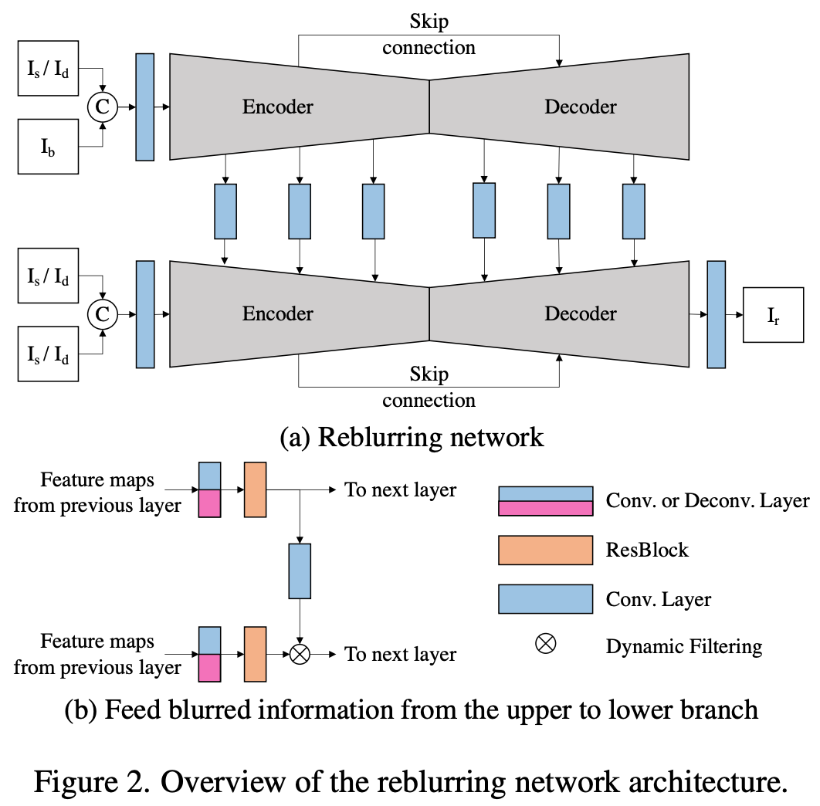
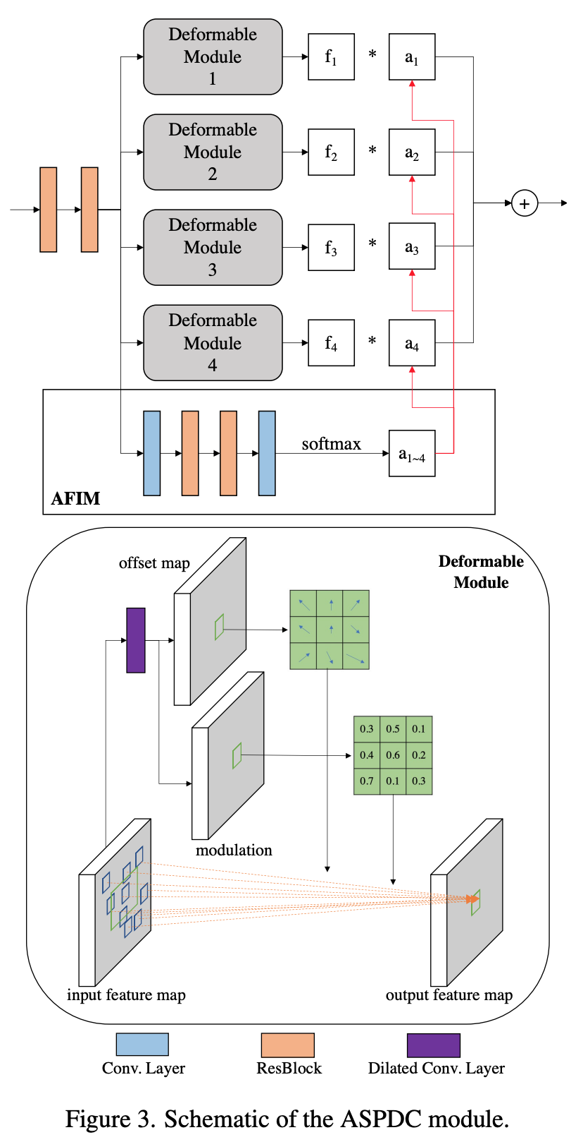
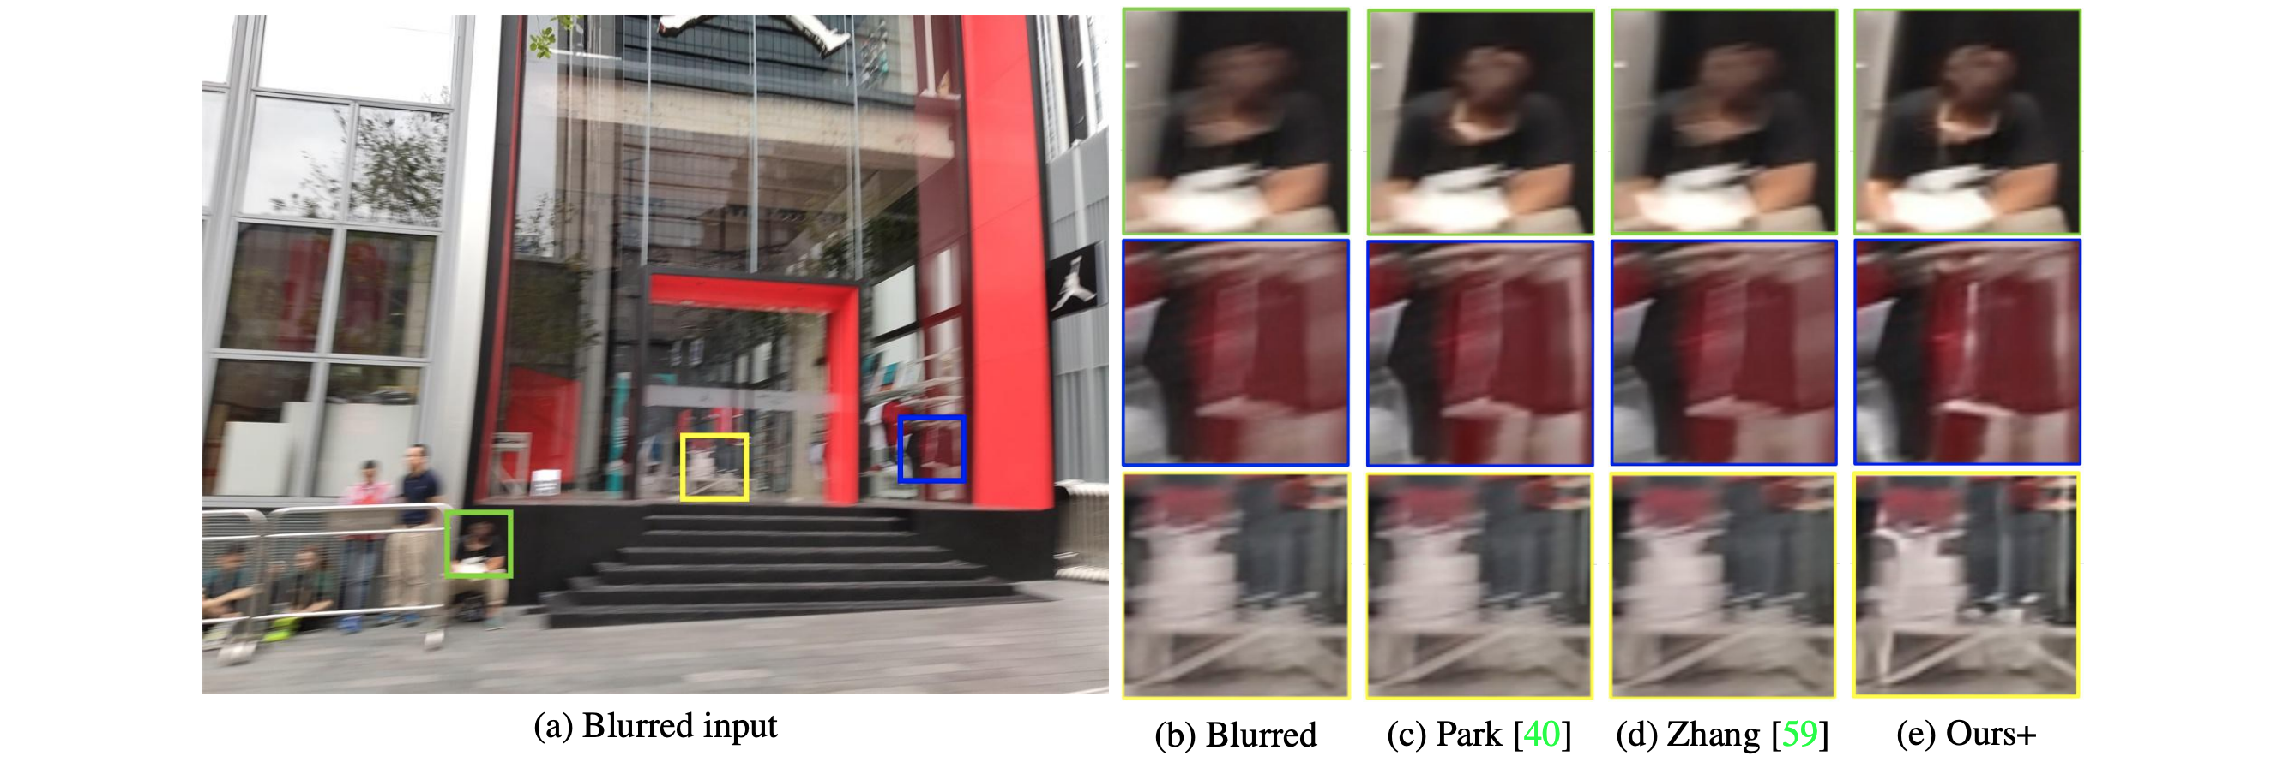
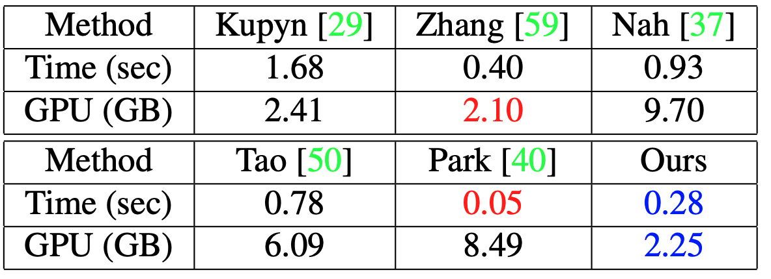
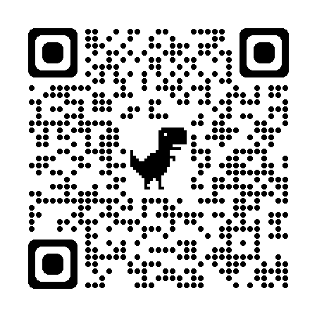
Blind Non-Uniform Motion Deblurring using Atrous Spatial Pyramid Deformable Convolution and Deblurring-Reblurring Consistency Dong Huo, Abbas Masoumzadeh, Yee-Hong Yang
Problem:
Qualitative comparison
Attention masks
Problem:
Same convolutional kernel for different blur
High computational cost of multi-stage [1] [2] [3] architecture
Results:
Problem:
Contribution:
Atrous Spatial Pyramid Deformable Convolution (ASPDC) module
Single-stage architecture
Deblurring-Reblurring Consistency
Contribution:
Method:
Method:
Problem:
Quantitative comparison
Efficiency Reblurring evaluation
Results:
Conclusion:
Problem:
We propose a new single-stage network for deblurring with high efficiency and low computational cost
Different magnitude of blur on the same image exploits different convolutional kernels within ASPDC module
Deblurring-reblurring consistency achieves better performance
https://github.com/Dong-Huo/ASPDC
Project Link:
Reference:
Problem:
[1] Deep multi-scale convolutional neural network for dynamic scene deblurring.
[2] Spatially-attentive patch-hierarchical network for adaptive motion deblurring
[3] Multi-temporal recurrent neural networks for progressive non-uniform single image deblurring with incremental temporal training

