Slide 1
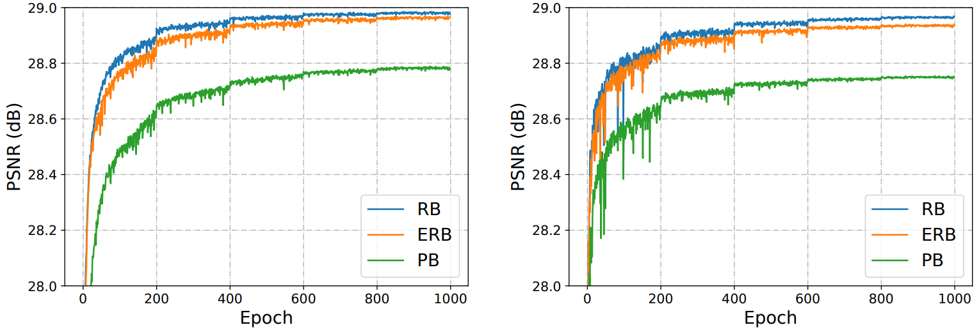
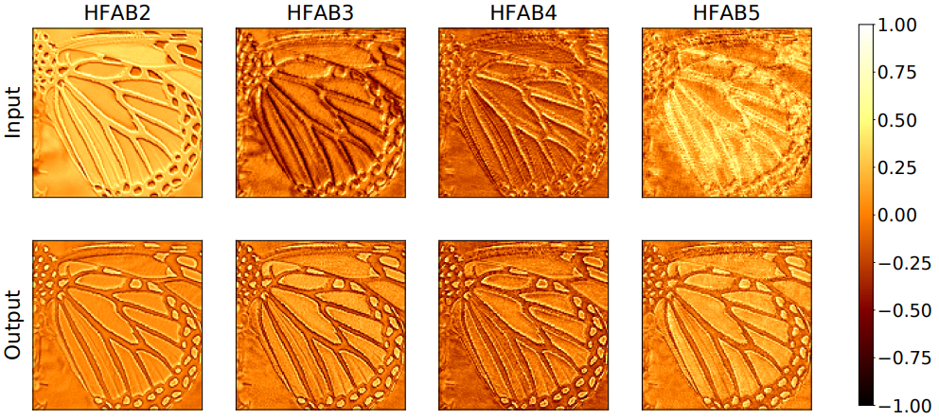
Fast and Memory-Efficient Network Towards Efficient Image Super-Resolution Zongcai Du¹, Ding Liu², Jie Liu¹, Jie Tang¹, Gangshan Wu¹, Lean Fu²
¹Nanjing University, ²Bytedance Inc.
Problems and Contributions
Effectiveness of ERB and HFAB
Existing Problem:
Widely used distillation and aggregation strategies in efficient super-resolution lead to huge memory consumption and runtime overheads.
Key Contributions:
We propose an enhanced residual block (ERB) to utilize residual learning with faster speed and less memory consumption.
We propose a high frequency attention block (HFAB) to enhance high-frequency features.
Performance comparison when applying different blocks to EDSR-baseline (left) and FMEN (right).
Visualization of feature maps before and after HFAB.
Proposed Method
Inference speed comparison when applying RB and ERB to three models.
Comparison with other attention mechanisms.
Efficiency Metrics
Comparison of plain block (PB) , residual block (RB) and proposed enhanced residual block (ERB).
code link
The whole architecture of fast and memory-efficient network (FMEN).
Top methods of NTIRE 2022 Challenge on Efficient Super-Resolution. Red indicates the best and the blue indicates the second best.
paper link

