Slide 1
Challenges and Solutions for Intelligent Image Restoration
Lin Liu
Huawei Cloud BU

Slide 2
Outline
Introduction
Tasks of image restoration
General intelligent image restoration Model
Data: Real data is difficult to obtain
1. Synthesize more realistic data
2. Self-supervised Learning
3. Pre-trained Model
Model: Existing models are not capable of mining useful information
1. Introducing Guidance Information
Self-guidance
External guidance
2. Mining Frequency Domain Information
Conclusion

Slide 3
Outline
Introduction
Tasks of image restoration
General intelligent image restoration Model
Data: Real data is difficult to obtain
1. Synthesize more realistic data
2. Self-supervised Learning
3. Pre-trained Model
Model: Existing models are not capable of mining useful information
1. Introducing Guidance Information
Self-guidance
External guidance
2. Mining Frequency Domain Information
Conclusion

Slide 4
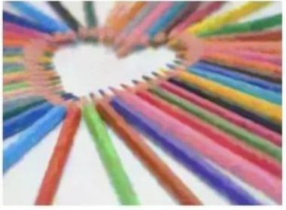
Introduction
Problem definition
Image restoration (IR): The operation of taking a corrupt/noisy image and estimating the clean, original image.
Corrupt by motion blur/noise/mis-focus…
Estimating the clean image
Difference from image enhancement (IE)
IE:
Emphasize features of the images;
Make the image more pleasing to the observer;

Slide 5
Outline
Introduction
Tasks of image restoration
General intelligent image restoration Model
Data: Real data is difficult to obtain
1. Synthesize more realistic data
2. Self-supervised Learning
3. Pre-trained Model
Model: Existing models are not capable of mining useful information
1. Introducing Guidance Information
Self-guidance
External guidance
2. Mining Frequency Domain Information
Conclusion

Slide 6
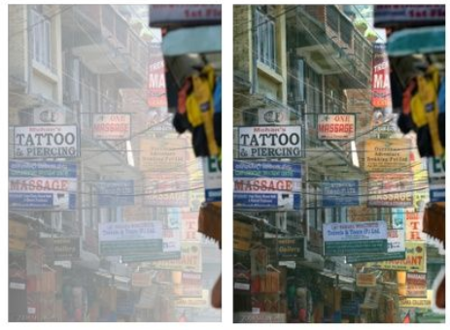
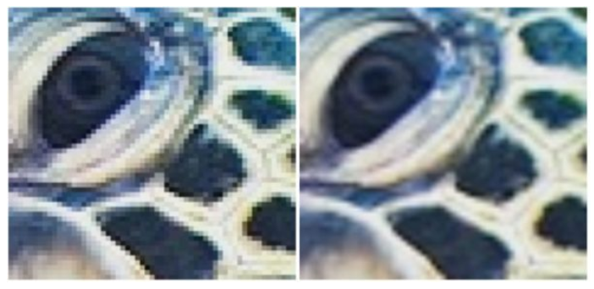
Tasks of image restoration
Denoising
Deraining
Blur removal
Demoireing
Dehazing
Super resolution

Slide 7
Outline
Introduction
Tasks of image restoration
General intelligent image restoration Model
Data: Real data is difficult to obtain
1. Synthesize more realistic data
2. Self-supervised Learning
3. Pre-trained Model
Model: Existing models are not capable of mining useful information
1. Introducing Guidance Information
Self-guidance
External guidance
2. Mining Frequency Domain Information
Conclusion

Slide 8
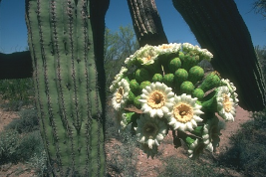
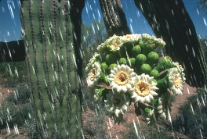
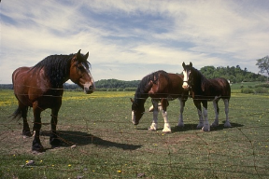
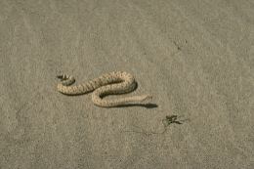
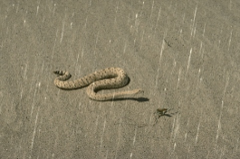
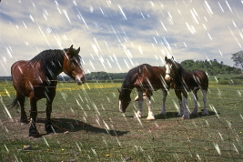
General Intelligent IR Model
Problem 1:
Real data pairs are difficult to obtain
Steps1: Collecting lots of noise/clean image pairs
…
Steps2: Training an end-to-end model
Problem 2:
Existing models are not capable of mining useful information
Network

Slide 9
Outline
Introduction
Tasks of image restoration
General intelligent image restoration Model
Data: Real data is difficult to obtain
1. Synthesize more realistic data
2. Self-supervised Learning
3. Pre-trained Model
Model: Existing models are not capable of mining useful information
1. Introducing Guidance Information
Self-guidance
External guidance
2. Mining Frequency Domain Information
Conclusion

Slide 10
Data
Problem 1:
Real data is difficult to obtain
Solutions:
1.1 Synthesize more realistic data
1.2 Self-supervised Learning
1.3 Pre-trained Model
Notes:
使用有监督的方法来训练神经网络应用于image restoration 任务通常需要大量成对的数据。这要涉及到图像获取，图像对齐等操作。十分耗费时间。而且有时候降质图像所对应的ground truth难以获得（例如摩尔纹对应的无摩尔纹的图像）。
因此需要一些方法来缓解数据紧缺的问题。第一种是利用合成的方法。一些研究探索更加真实的pipeline来合成数据。第二种是自监督学习，就是在没有降质图像所对应的ground truth的情况下，来学习一个clean的图像。第三种解决方法是利用预训练的网络，这里主要有利用预训练的GAN来做inversion和预训练的transformer，我们这里重点介绍2种transformer的方法。

Slide 11
Solution 1.1: Synthesize more Realistic Data
Motivation:
Synthesize more data to enhance the generalization ability of the network
Problem:
The pipeline/physical model is inaccurate.
Some processes are complex or unknown.

Slide 12
Solution 1.1 Synthesize more realistic data
Step 1. Resample the input RGB image into a mosaic of RGB subpixels to simulate the image displayed on the LCD.
Step 3. Resample the image using Bayer CFA to simulate the RAW data, and add Gaussian noise to simulate sensor noise.
Step 2. Apply a random projective transformation on the image to simulate different relative positions and orientations of the display and camera, and apply 3 × 3 Gaussian filter.
Step 4. Apply a simple ISP pipeline including de-mosaicing and de-noising. And compress the image using JPEG compression.
Shanxin Yuan et al. AIM 2019 Challenge on Image Demoireing: Dataset and Study. ICCV 2019
Notes:
传统的摩尔纹的合成方法包括RGB到RAW和RAW的demosaic两个过程（Moiré pattern removal from texture images via low-rank and sparse matrix decomposition），这种方法不适用于屏幕摩尔纹的生成模拟过程，而且也没有考虑到相机和屏幕的移动等情况。
在华为提供的摩尔纹的方案中，我们的合成屏幕摩尔纹的方法包含四个步骤：…

Slide 13
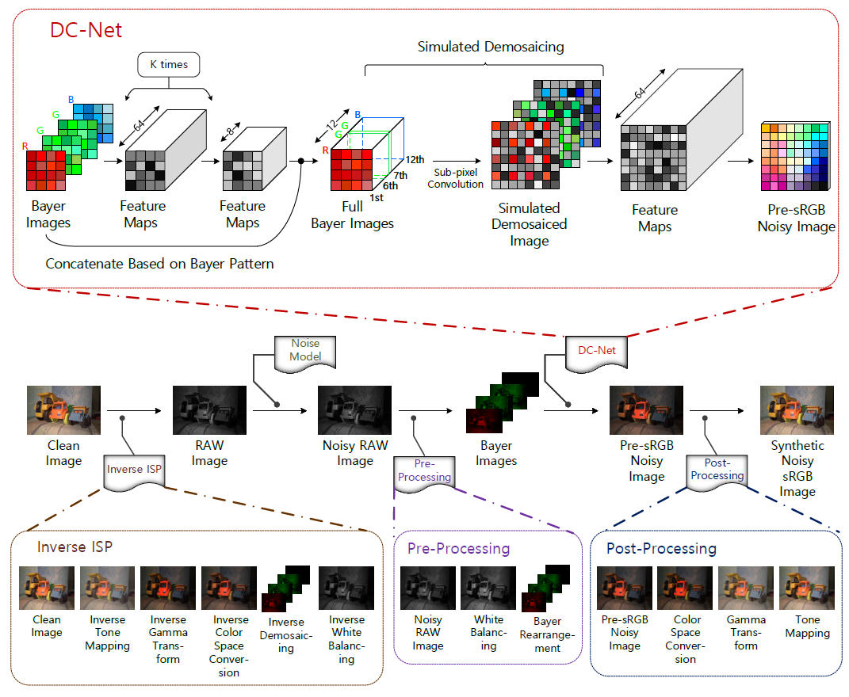
Solution 1.1 Synthesize more realistic data
Yao Li et al. Realistic sRGB Noisy Image Generation for Image Denoising.
Notes:
After going through a series of image signal processing (ISP) from the raw space to the sRGB space, the noise in sRGB images becomes too complicated to model.
Therefore, most denoising methods either simplify the real noise as Gaussian in the sRGB space or denoise in the raw space. The latter has the difficulty of capturing enough paired training data.
Researchers in Huawei propose an effective method to generate realistic sRGB noisy images from their corresponding clean sRGB images for denoiser training.

Slide 14
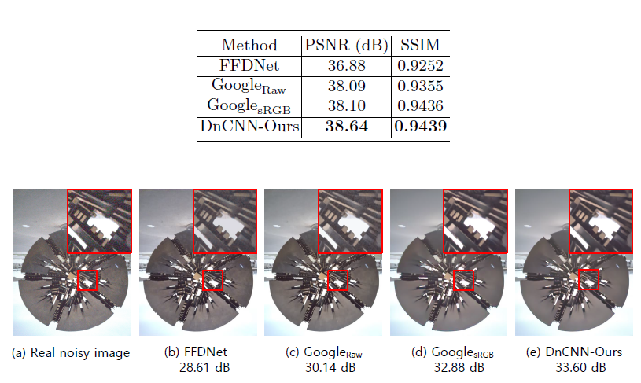
Solution 1.1 Synthesize more realistic data
Yao Li et al. Realistic sRGB Noisy Image Generation for Image Denoising.

Slide 15
Solution 1.2: Self-supervised Learning
Motivation:
When the Ground Truth is difficult to obtain, we can learn from the internal characteristics of degraded images

Slide 16
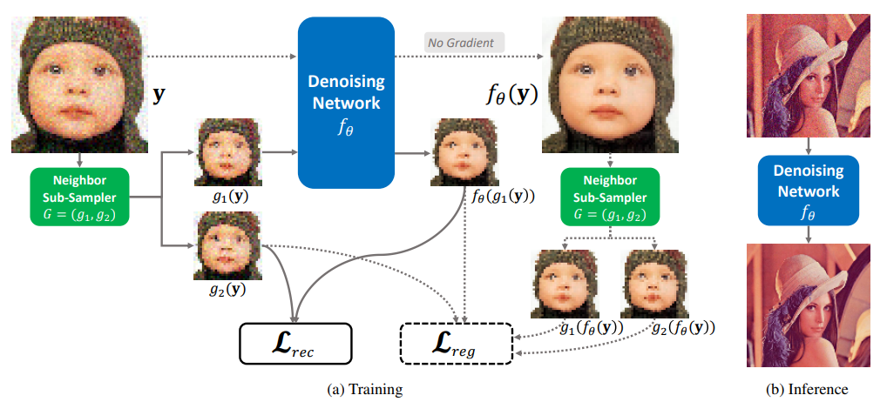
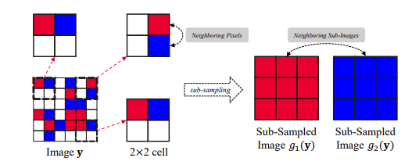
Solution 1.2 Self-supervised Learning
Tao Huang et al. Neighbor2Neighbor: Self-Supervised Denoising from Single Noisy Images. CVPR 2021
Notes:
Although there have been a few attempts in training an image denoising model with only single noisy images, existing self-supervised denoising approaches suffer from inefficient network training, loss of useful information, or dependence on noise modeling.
we present a very simple yet effective method named Neighbor2Neighbor to train an effective image denoising model with only noisy images

Slide 17
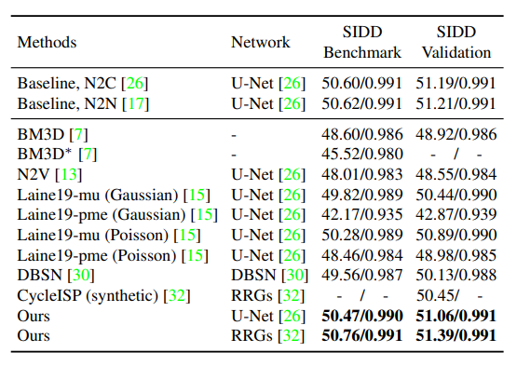
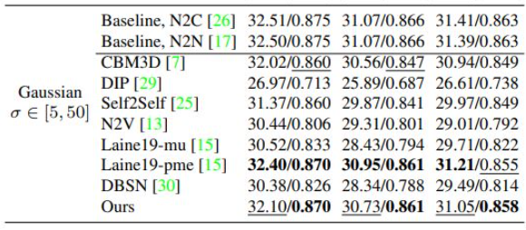
Solution 1.2 Self-supervised Learning
Tao Huang et al. Neighbor2Neighbor: Self-Supervised Denoising from Single Noisy Images. CVPR 2021

Slide 18
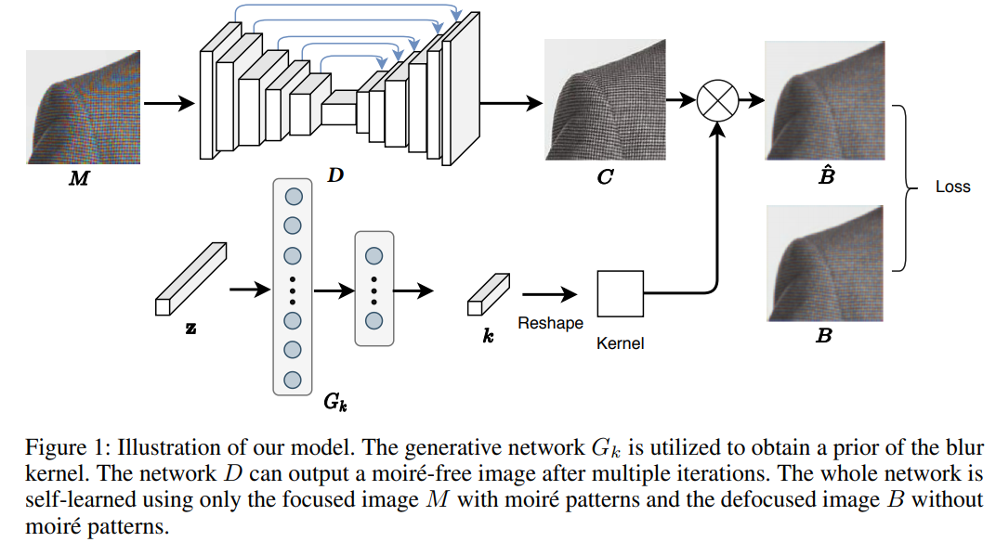
Solution 1.2 Self-supervised Learning
Lin Liu et al. Self-adaptively learning to demoire from focused and defocused image pairs. NeurIPS 2020
Notes:
obtaining moiré-free ground-truth in natural scenes is difficult but needed for training.
In this paper, we propose a self-adaptive learning method for demoiréing a high-frequency image, with the help of an additional defocused moiré-free blur image.
Given an image degraded with moiré artifacts and a moiré-free blur image, our network predicts a moiré-free clean image and a blur kernel with a self-adaptive strategy that does not require an explicit training stage.

Slide 19
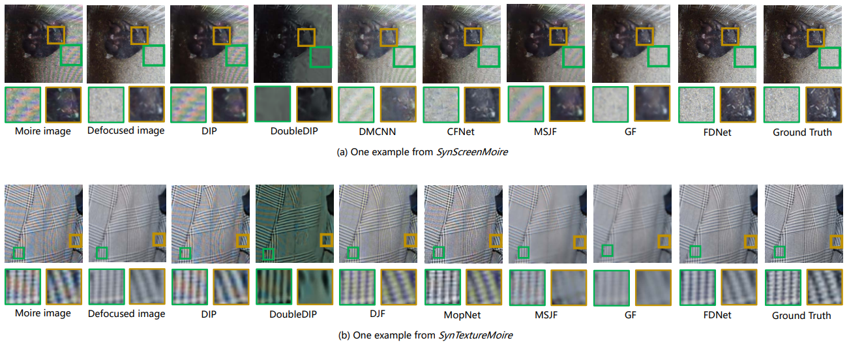
Solution 1.2 Self-supervised Learning
Lin Liu et al. Self-adaptively learning to demoire from focused and defocused image pairs. NeurIPS 2020

Slide 20
Solution 1.3: Pre-trained Model
Motivation:
The pre-trained model trained on different tasks and large scale dataset can obtain natural image prior.
Problem:
The pre-trained model needs to be compatible with different image processing tasks.
large-scale dataset must be used.

Slide 21
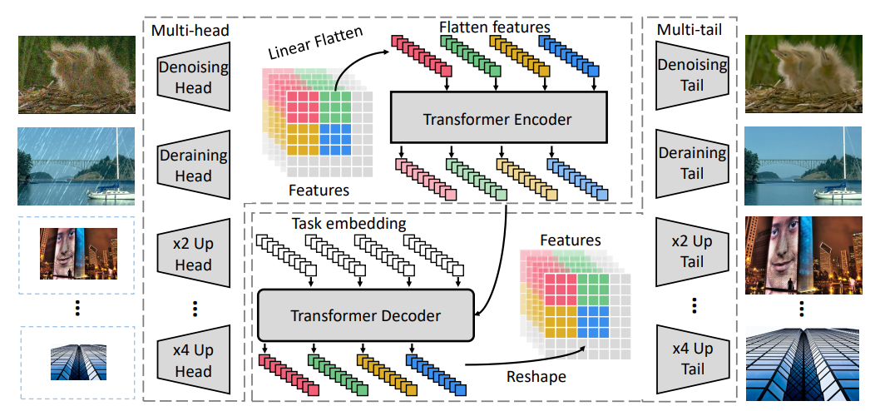
Solution 1.3 Pre-trained Model
Hanting Chen et al. Pre-Trained Image Processing Transformer. CVPR 2021
Notes:
Researchers in Huawei develop a new pretrained model, namely, image processing transformer (IPT).
To maximally excavate the capability of transformer, they present to utilize the well-known ImageNet benchmark for generating a large amount of corrupted image pairs.
The IPT model is trained on these images with multi-heads and multi-tails.

Slide 22
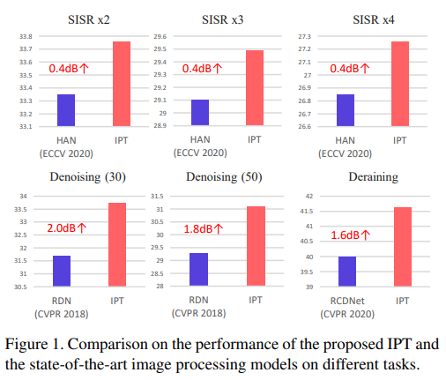
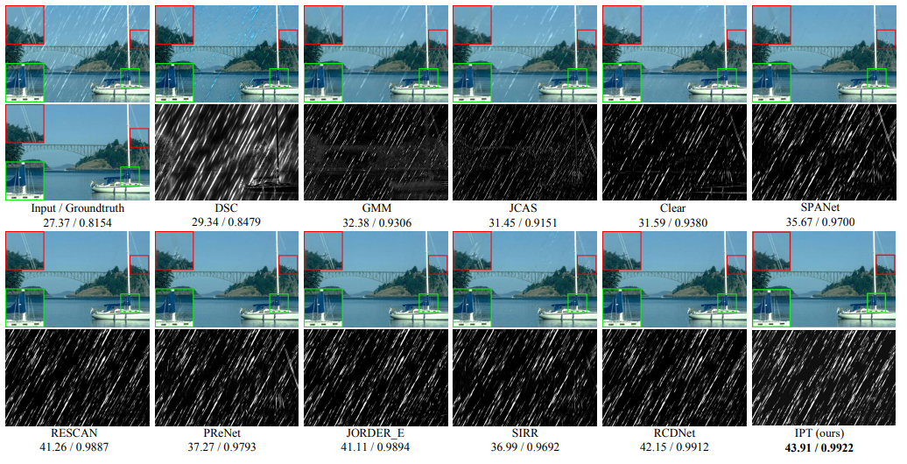
Solution 1.3 Pre-trained Model
Hanting Chen et al. Pre-Trained Image Processing Transformer. CVPR 2021

Slide 23
Outline
Introduction
Tasks of image restoration
General intelligent image restoration Model
Data: Real data is difficult to obtain
1. Synthesize more realistic data
2. Self-supervised Learning
3. Pre-trained Model
Model: Existing models are not capable of mining useful information
1. Introducing Guidance Information
Self-guidance
External guidance
2. Mining Frequency Domain Information
Conclusion

Slide 24
Model
Problem 2:
Existing models are not capable of mining useful information
Solution:
2.1 Introducing Guidance Information
Self-guidance
External guidance
2.2 Mining Frequency Domain Information

Slide 25
Solution 2.1: Introducing Guidance Information
Self guidance:
Get some information or prior knowledge from the degraded images.
More challenging than external guidance
External guidance:
Obtain some useful information from other images
E.g. super-resolution (depth map);

Slide 26
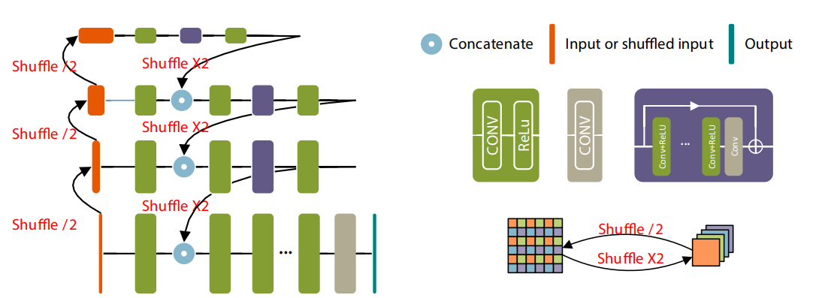
Solution 2.1 Introducing guidance information
—self guidance
Shuhang Gu et al. Self-Guided Network for Fast Image Denoising.
ICCV 2019
Notes:
通过shuffle构建更低分辨率的特征，来帮助更高分辨率的特征去噪。这是通过挖掘图像低分辨率的信息的一种自引导修复方法。

Slide 27
Solution 2.1 Introducing guidance information
—self guidance
Shuhang Gu et al. Self-Guided Network for Fast Image Denoising.
ICCV 2019

Slide 28
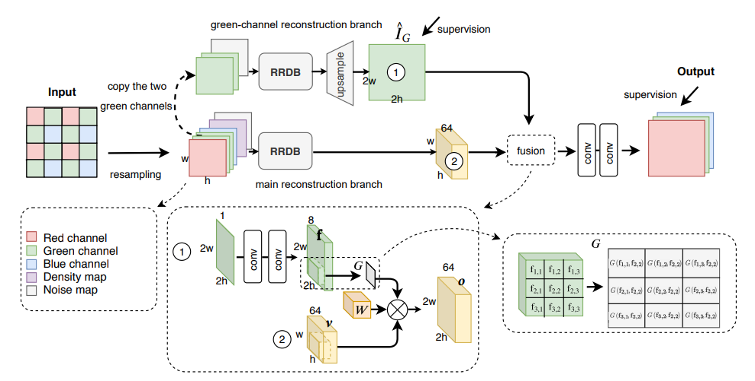
Solution 2.1 Introducing guidance information
—self guidance
Green channel guidance
Adaptive guidance, not just simply concatenate
Lin Liu et al. Joint demosaicing and denoising with self guidance.
CVPR 2020
Notes:
通过修复G通道，在用G通道引导其他两个通道来进行demosaicing和去噪任务。这是通过挖掘图像自身的信息的一种自引导修复方法。

Slide 29
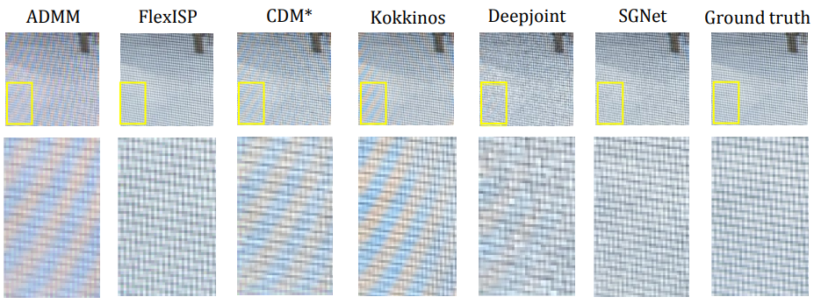
Solution 2.1 Introducing guidance information
—self guidance
Ours
Lin Liu et al. Joint demosaicing and denoising with self guidance.
CVPR 2020

Slide 30
Solution 2.1 Introducing guidance information
—external guidance
Introducing defocused image to moire pattern removal
Lin Liu et al. Self-adaptively learning to demoire from focused and defocused image pairs. NeurIPS 2020
Notes:
引入散焦图像来去摩尔纹

Slide 31
Solution 2.1 Introducing guidance information
—external guidance
Introducing flash image to reflection removal
Chenyang Lei et al. Robust Reflection Removal with Reflection-free Flash-only Cues.
CVPR 2021
Notes:
引入闪光图像来去反光

Slide 32
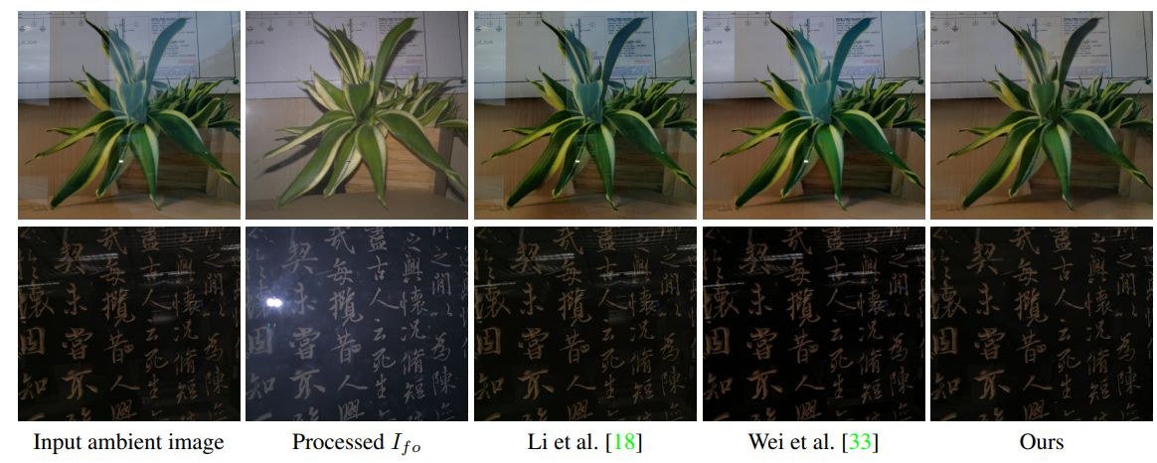
Solution 2.1 Introducing guidance information
—external guidance
Chenyang Lei et al. Robust Reflection Removal with Reflection-free Flash-only Cues.
CVPR 2021
Notes:
引入闪光图像来去反光

Slide 33
Solution 2.2: Mining Frequency Domain Information
Motivation:
Some tasks are difficult in the spatial domain.
Issues:
Which frequency transform should we use?
How to use?

Slide 34
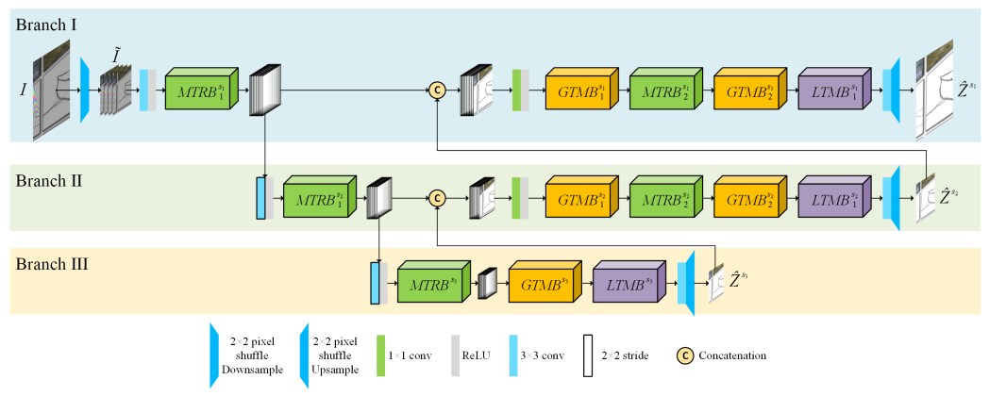
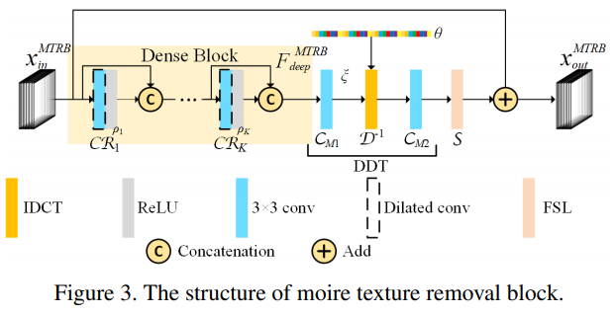
Solution 2.2 Mining Frequency Domain Information
The structure of moire texture removal block (MTRB).
Bolun Zheng et al. Image Demoireing with Learnable Bandpass Filters.
CVPR 2020
Notes:
我们以去摩尔纹问题为例讲述引入频域信息在image restoration问题中的重要性。第一篇文章zheng等人设计了一个MTRB模块，用来预测DCT域的参数。第二篇文章，liu等人预测target图像在小波域的参数，来更好的完成去摩尔纹任务。

Slide 35
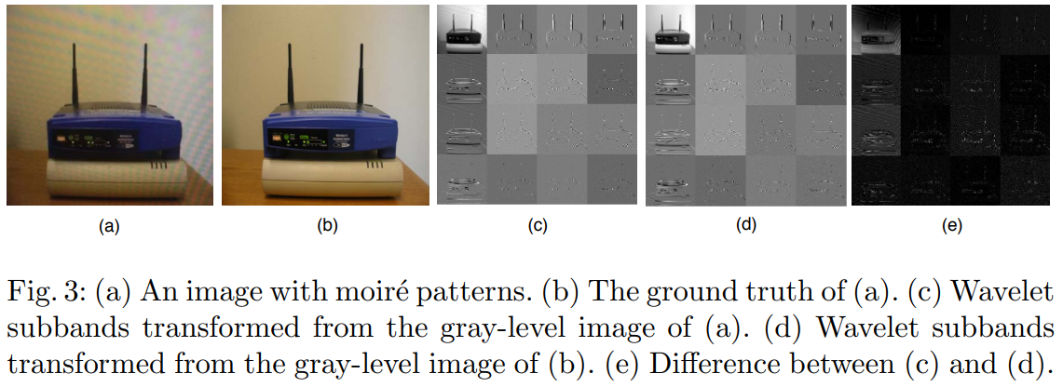
Solution 2.2 Mining Frequency Domain Information
Lin Liu et al. Wavelet-Based Dual-Branch Network for Image Demoireing.
ECCV 2020

Slide 36
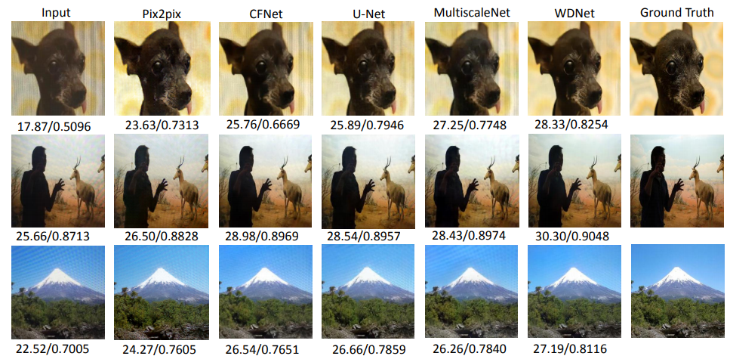
Solution 2.2 Mining Frequency Domain Information
Bolun Zheng et al. Image Demoireing with Learnable Bandpass Filters. CVPR 2020
Lin Liu et al. Wavelet-Based Dual-Branch Network for Image Demoireing. ECCV 2020

Slide 37
Discussion
Drawback:
S 1.2 Self-supervised Learning is task-specific design.
S 1.3 There are data bias between pre-training dataset and downstream test set.
S 2.1 Sometimes collecting external information is complex and cost more time.

Slide 38
Outline
Introduction
Tasks of image restoration
General intelligent image restoration Model
Data: Real data is difficult to obtain
1. Synthesize more realistic data
2. Self-supervised Learning
3. Pre-trained Model
Model: Existing models are not capable of mining useful information
1. Introducing Guidance Information
Self-guidance
External guidance
2. Mining Frequency Domain Information
Conclusion

Slide 39
Conclusion
Problem 1: Real data is difficult to obtain
S 1.1 Synthesize more realistic data
S 1.2 Self-supervised Learning
S 1.3 Pre-trained Model
Problem 2: Existing models are not capable of mining useful information
S 2.1 Introducing Guidance Information
Self-guidance
External guidance
S 2.2 Mining Frequency Domain Information

Slide 40
Reference
Shanxin Yuan et al. AIM 2019 Challenge on Image Demoireing: Dataset and Study. ICCV 2019
Yao Li et al. Realistic sRGB Noisy Image Generation for Image Denoising.
Tao Huang et al. Neighbor2Neighbor: Self-Supervised Denoising from Single Noisy Images. CVPR 2021
Hanting Chen et al. Pre-Trained Image Processing Transformer. CVPR 2021
Lin Liu et al. Self-adaptively learning to demoire from focused and defocused image pairs. NeurIPS 2020
Chenyang Lei et al. Robust Reflection Removal with Reflection-free Flash-only Cues. CVPR 2021
Bolun Zheng et al. Image Demoireing with Learnable Bandpass Filters. CVPR 2020
Lin Liu et al. Wavelet-Based Dual-Branch Network for Image Demoireing. ECCV 2020

