Slide 1
Visualizing and Understanding GANs
Jun-Yan Zhu
MIT CSAIL

Slide 2
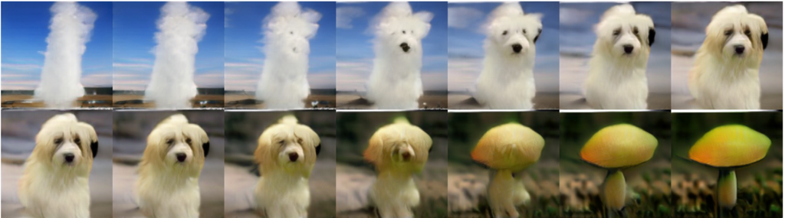
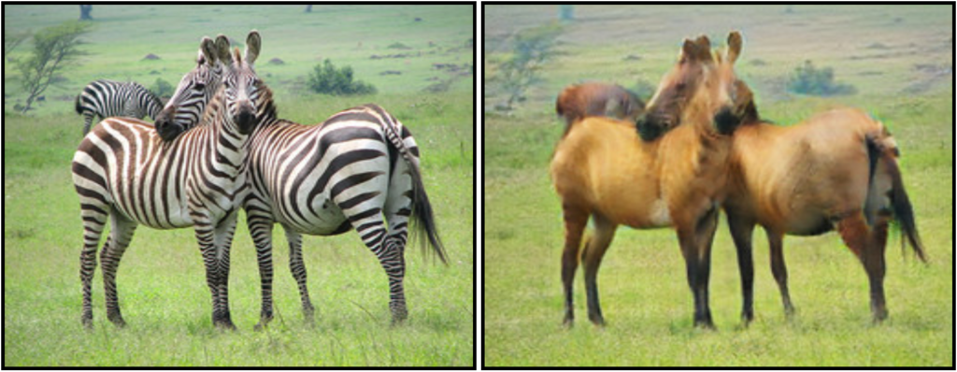
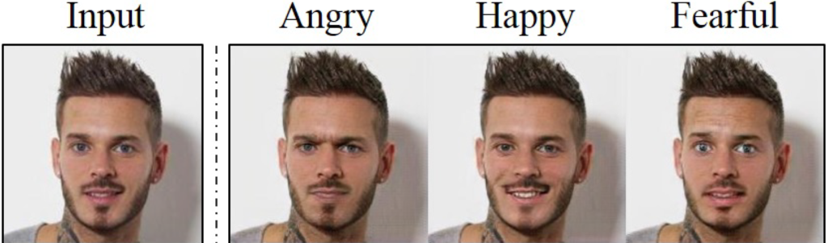
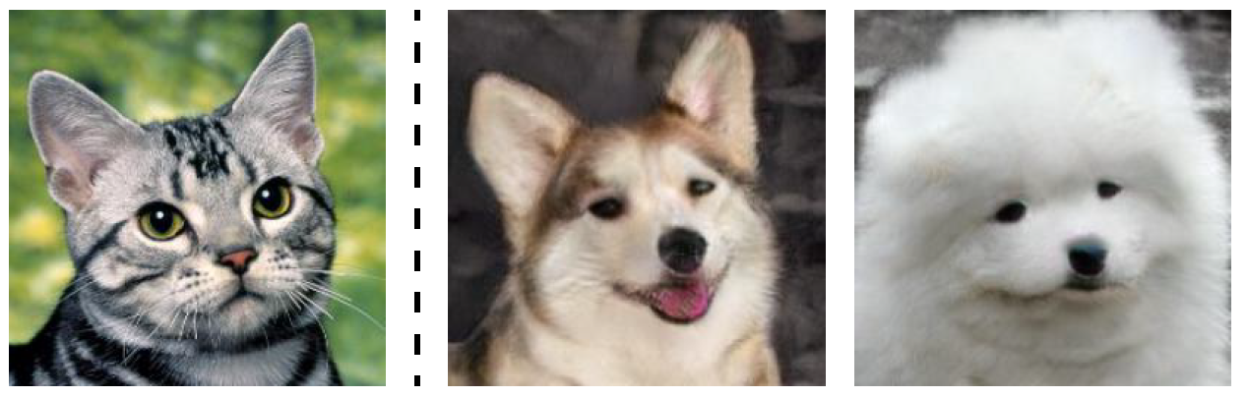
CycleGAN
[Zhu et al., ICCV 2017]
Projection Discriminator
[Miyato and Koyama, ICLR 2018]
MUNIT
[Huang et al., ECCV 2018]
StarGAN
[Choi et al., CVPR 2018]

Slide 3
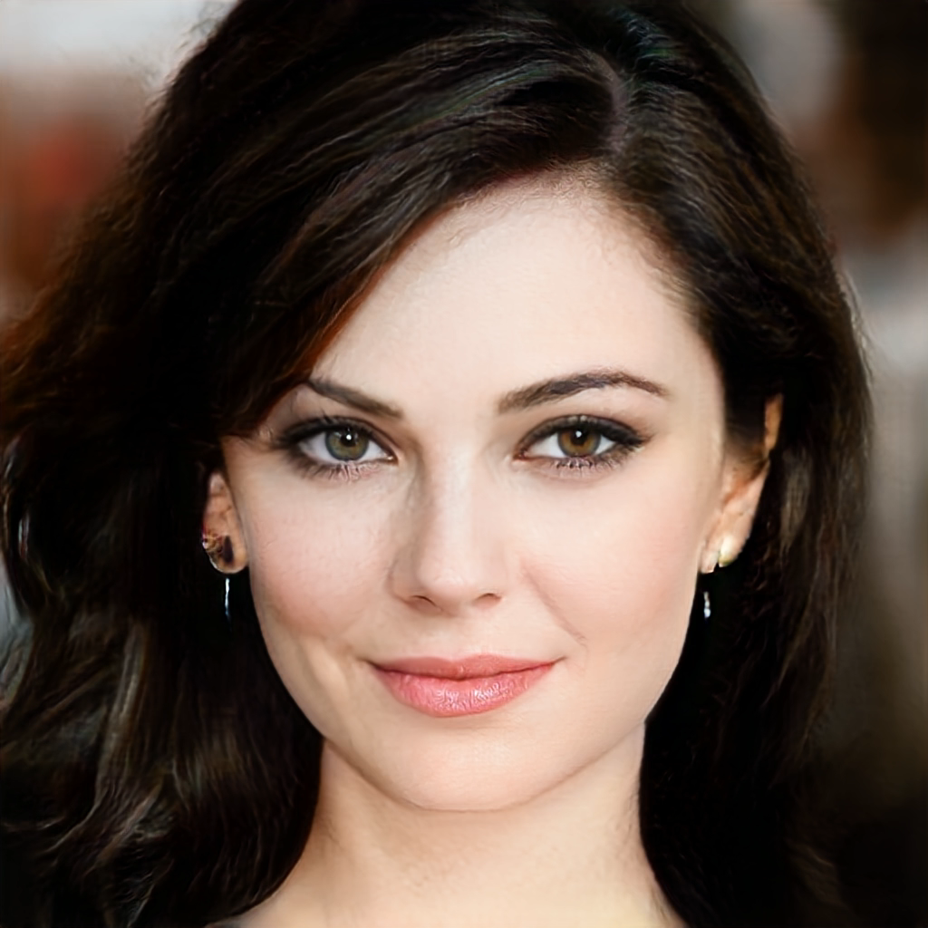
CycleGAN
[Zhu et al., ICCV 2017]
Projection Discriminator
[Miyato and Koyama, ICLR 2018]
MUNIT
[Huang et al., ECCV 2018]
StarGAN
[Choi et al., CVPR 2018]
Progressive GANs [Karras et al. ICLR 2018]

Slide 4
To render a natural image,
What has a model learned?
Church
Progressive GANs [Karras et al. 2018]

Slide 5
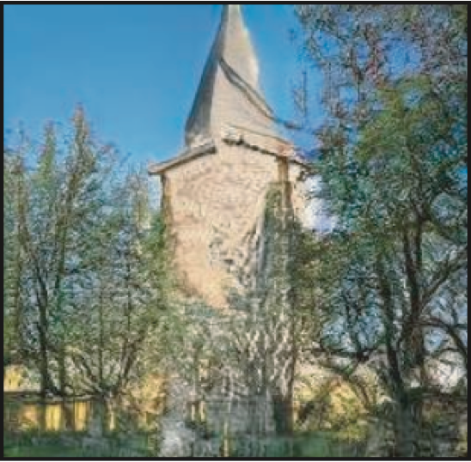
Dissecting a Generator
Each step:
Increases spatial resolution
Output image
Each layer consists of a set of neurons
width
Input: random vector z
height
Examine each neuron
What happens inside?
Progressive GANs [Karras et al. 2018]

Slide 6


Which neurons correlate to an object class?
generated image
generate
$$z$$
generator
[Bau, Zhu, Strobelt, Zhou, Tenenbaum, Freeman, Torralba. ICLR 2019]

Slide 7
Which neurons correlate to an object class?
featuremap
single neuron
generated image
generate
$$z$$
generator
[Bau, Zhu, Strobelt, Zhou, Tenenbaum, Freeman, Torralba. ICLR 2019]

Slide 8

Which neurons correlate to an object class?
featuremap
high response
single neuron
generated image
generate
$$z$$
generator
[Bau, Zhu, Strobelt, Zhou, Tenenbaum, Freeman, Torralba. ICLR 2019]

Slide 9



Which neurons correlate to an object class?
featuremap
high response
single neuron
agreement
generated image
sky
building
generate
$$z$$
labeling
tree
generator

Slide 10
Which neurons correlate to an object class?
Church samples
Tree
Neuron
Dome
Neuron

Slide 11
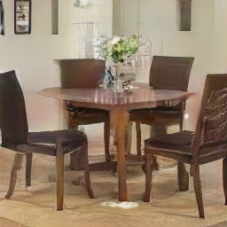
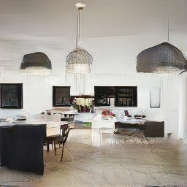
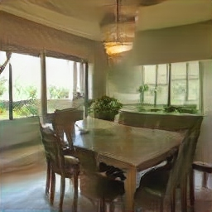
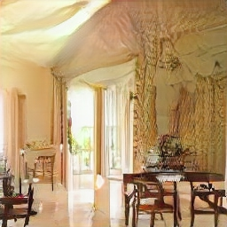
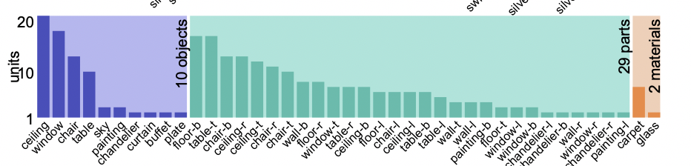
Which neurons correlate to an object class?
Dining room samples
252 out of 512 neurons are correlated to objects, part, and materials
Window
Neuron
Table
Neuron

Slide 12
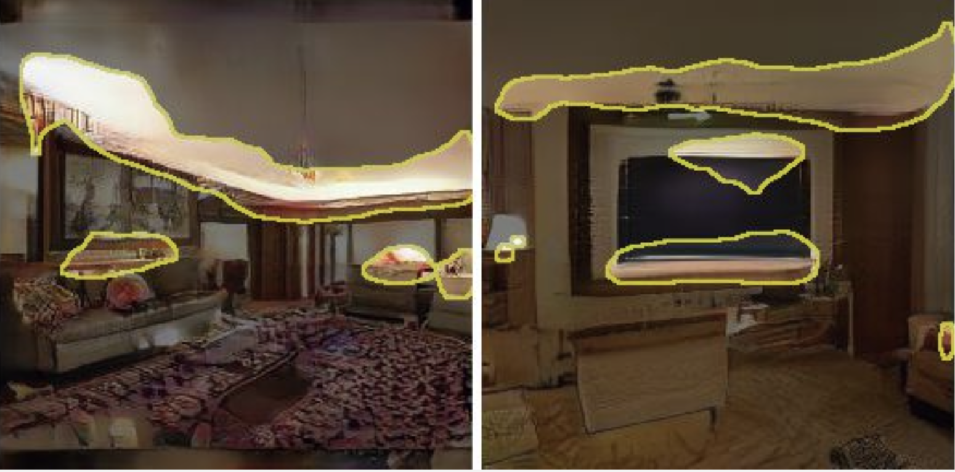
Which neurons correlate to an object class?
Living room model
code
Image
Layout
Object and parts
Edges, textures, local structure

Slide 13


Which neurons cause an object class?
featuremap
single neuron
generated image
generate
$$z$$
generator
[Bau, Zhu, Strobelt, Zhou, Tenenbaum, Freeman, Torralba. ICLR 2019]

Slide 14
Which neurons cause an object class?
featuremap
turn off the neuron
single neuron
generated image
Image with neuron off
generate
$$z$$
generator
[Bau, Zhu, Strobelt, Zhou, Tenenbaum, Freeman, Torralba. ICLR 2019]

Slide 15

Which neurons cause an object class?
featuremap
turn off the neuron
single neuron
generated image
Image with neuron off
generate
$$z$$
generator
[Bau, Zhu, Strobelt, Zhou, Tenenbaum, Freeman, Torralba. ICLR 2019]

Slide 16

Which neurons cause an object class?
featuremap
turn off the neuron
turn on the neuron
single neuron
generated image
Image with neuron off
Image with neuron on
generate
$$z$$
generator
average causal effect

Slide 17
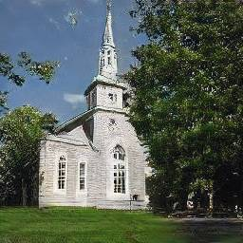
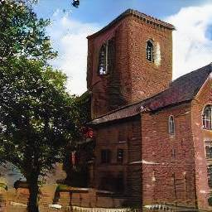
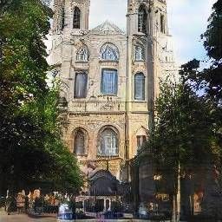
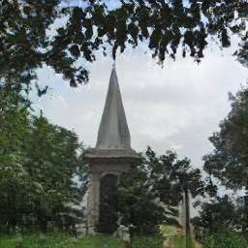
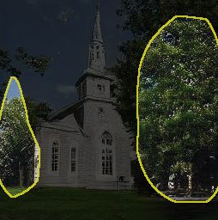
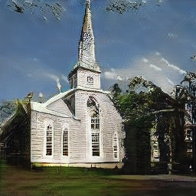
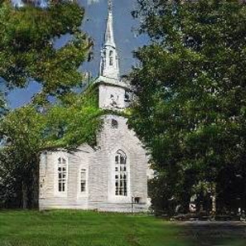
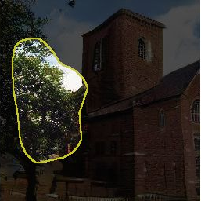
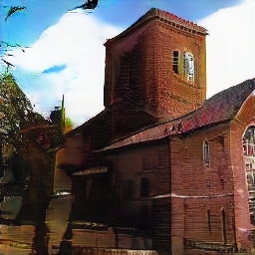
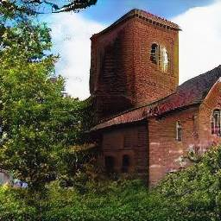
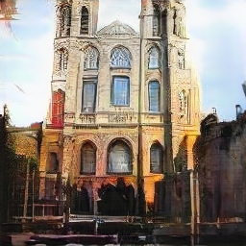
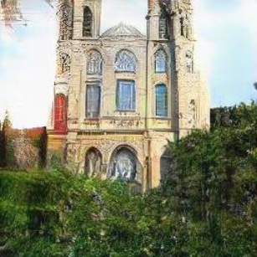
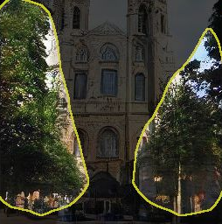
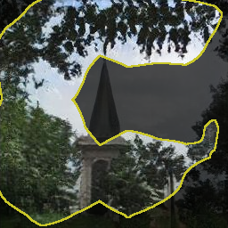
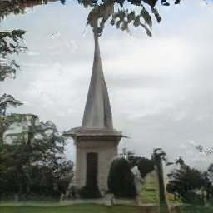
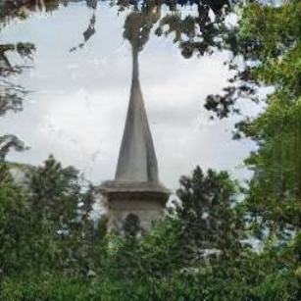
Which neurons cause an object class?

Slide 18
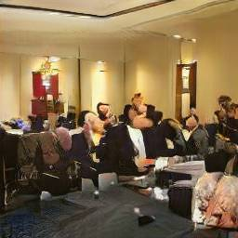
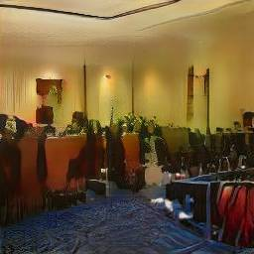
Object-Scene Relationships
Turn off person neurons

Slide 19
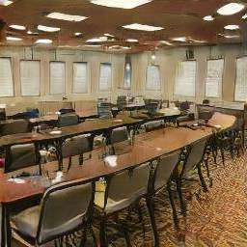
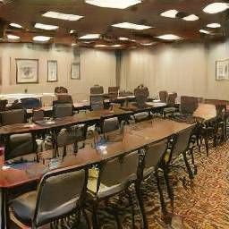
Object-Scene Relationships
Turn off window neurons

Slide 20
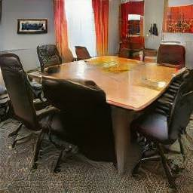
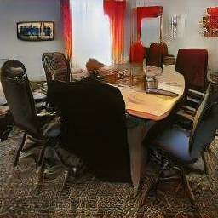
Object-Scene Relationships
Turn off table neurons

Slide 21
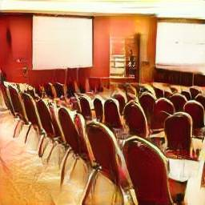
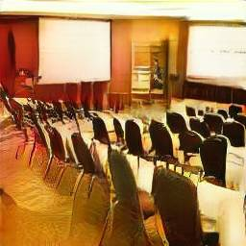
Object-Scene Relationships
Turn off chair neurons

Slide 22
Object-Scene Relationships

Slide 23
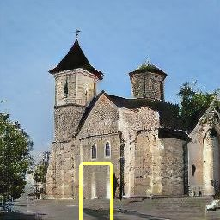
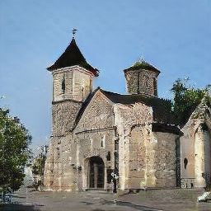
Object-Scene Relationships
Yellow box: highlight every location where we can insert doors

Slide 24
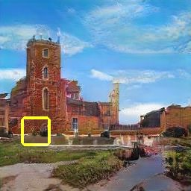

Object-Scene Relationships
Yellow box: highlight every location where we can insert doors

Slide 25
Object-Scene Relationships

Slide 26
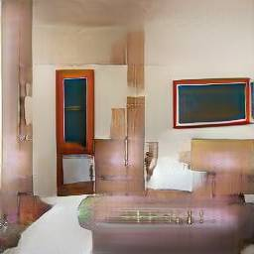
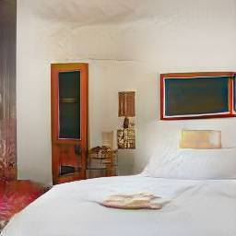
Debugging and Improving Models
Neuron #63
Neuron #231
Turning off neurons removes artifacts
Images with artifacts
Example artifact-causing neurons

Slide 27
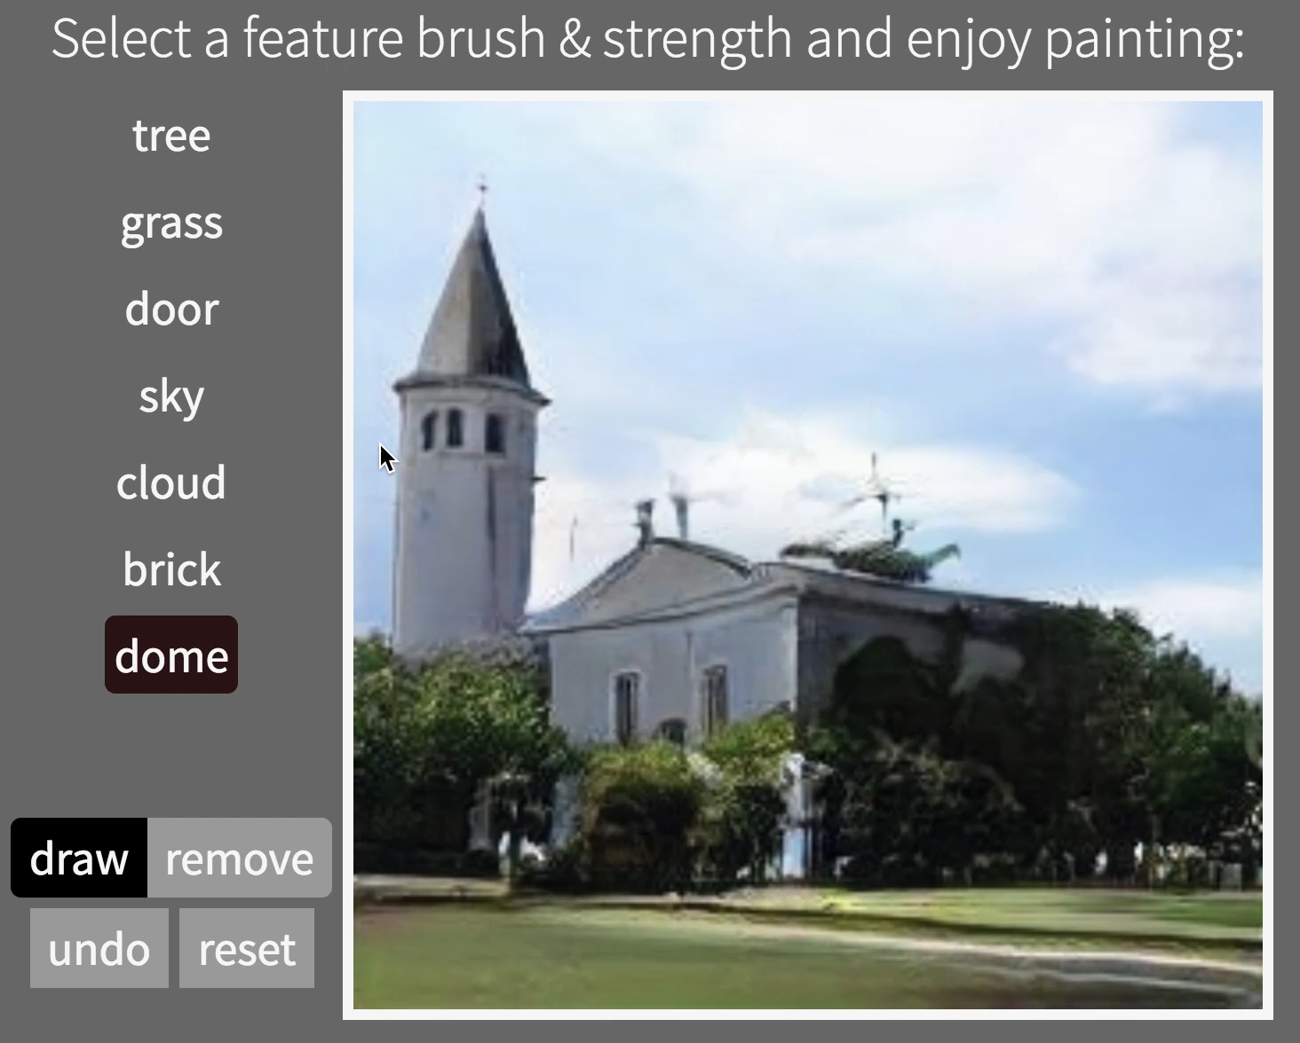

Interactive Painting
Online Demo
http://bit.ly/ganpaint

Slide 28
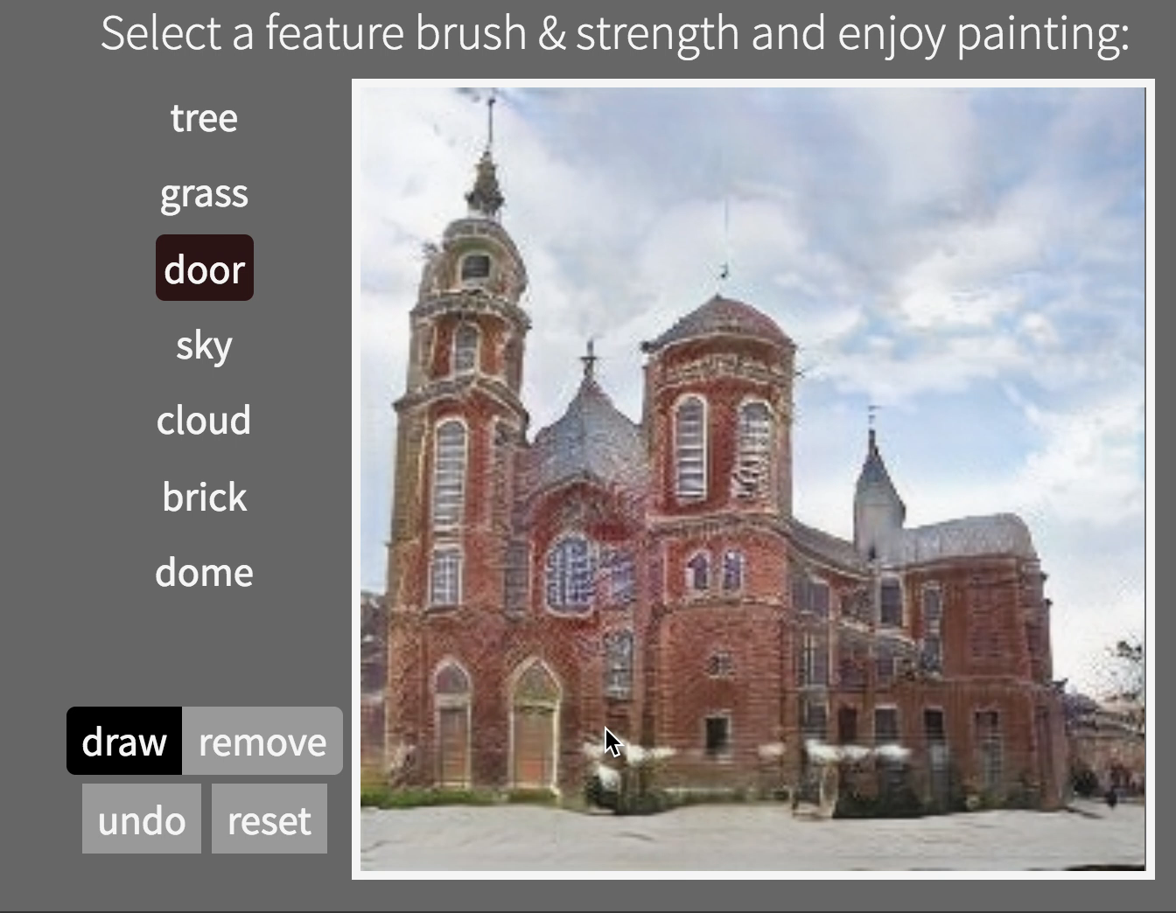
Interactive Painting
Online Demo
http://bit.ly/ganpaint

Slide 29

Manipulating a Real Photo
Original image $I$
Many slides borrowed from Antonio Torralba

Slide 30



Manipulating a Real Photo
Random
vector z?
Original image $I$

Slide 31

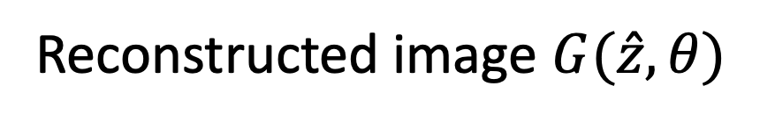
Reconstructing a Real Photo
Random
vector
Reconstructed image $G(\hat{z},θ)$

Slide 32
Find the Differences…
Original image
GAN reconstructed image

Slide 33
Find the Differences…
No lamp
No microwave
No window
No stove
No chairs/table
No something there
No plug
Original image
GAN reconstructed image

Slide 34
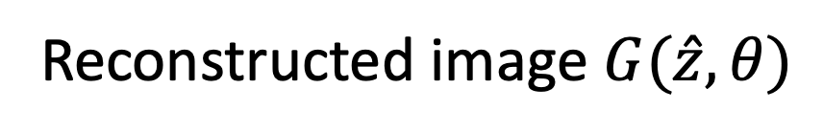
Reconstructing a Real Photo
Original image
Random
vector
Reconstructed image $G(\hat{z},θ)$
iGAN [Zhu et al. 2016]

Slide 35


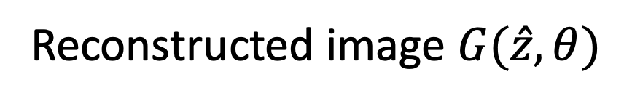
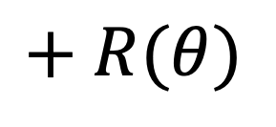
Reconstructing a Real Photo
Original image
Random
vector
Reconstructed image $G(\hat{z},θ)$
$$+ R(θ)$$
Regularizer

Slide 36

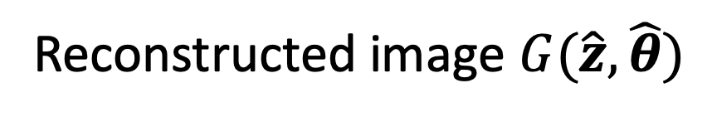
Reconstructing a Real Photo
Original image
Random
vector
Reconstructed image $G(\hat{z},\hat{θ})$
$$+ R(θ)$$
Regularizer

Slide 37

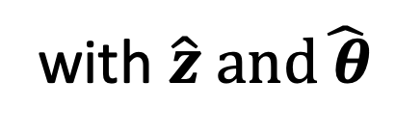
Reconstructing a Real Photo
Original image
with $\hat{z}$
with $\hat{z} and\hat{ θ}$
Semantic Photo Manipulation [Bau, Strobelt, Peebles, Wulff, Zhou, Zhu, Torralba, SIGGRAPH 2019]
Inspired by Deep Image Prior [Ulyanov et al.] and Deep Internal learning [Shocher et al.]

Slide 38
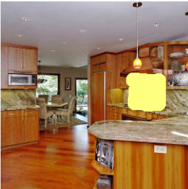




Manipulating a Real Photo via GAN Dissection
Original image + edits
Editing with $\hat{z}$
Editing with $\hat{z} and\hat{ θ}$
Semantic Photo Manipulation [Bau, Strobelt, Peebles, Wulff, Zhou, Zhu, Torralba, SIGGRAPH 2019]
GAN Dissection [Bau, Zhu, Strobelt, Zhou, Tenenbaum, Freeman, Torralba. ICLR 2019]
]

Slide 39



Manipulating a Real Photo via GAN Dissection
Input image
Remove chairs
Output result
Semantic Photo Manipulation [Bau, Strobelt, Peebles, Wulff, Zhou, Zhu, Torralba, SIGGRAPH 2019]
GAN Dissection [Bau, Zhu, Strobelt, Zhou, Tenenbaum, Freeman, Torralba. ICLR 2019]
]

Slide 40



Manipulating a Real Photo via GAN Dissection
Input image
Add windows
Output result
Semantic Photo Manipulation [Bau, Strobelt, Peebles, Wulff, Zhou, Zhu, Torralba, SIGGRAPH 2019]
GAN Dissection [Bau, Zhu, Strobelt, Zhou, Tenenbaum, Freeman, Torralba. ICLR 2019]
]

Slide 41



Manipulating a Real Photo via GAN Dissection
Input image
Restyle trees for spring
Restyle trees for autumn
Semantic Photo Manipulation [Bau, Strobelt, Peebles, Wulff, Zhou, Zhu, Torralba, SIGGRAPH 2019]
GAN Dissection [Bau, Zhu, Strobelt, Zhou, Tenenbaum, Freeman, Torralba. ICLR 2019]
]

Slide 42


Slide 43


Acknowledgement
David Bau
Hendrik Strobelt
Jonas Wulff
William Peebles
Bolei Zhou
William T. Freeman
Joshua Tenenbaum
Antonio Torralba

Slide 44
Thank You!
All the code and data are available on
https://gandissect.csail.mit.edu/
Notes:
thank you for your attention.

